Slide 1
Introduction to Microsoft .NET
By: Zachary McKinnon

Slide 2
About Me
Software Engineer (10 years)
Curse
Contact
Github - https://github.com/zmckinnon
.NET Meetup - https://www.meetup.com/Huntsville-NET-Meetup
Tech256 - http://tech256.com

Slide 3
DevSpace
Oct. 12th & 13th
VBC
https://www.devspaceconf.com

Slide 4
About this Presentation
The Basics
.NET Landscape
Documentation
Visual Studio Code
C# - Basics
Demo
Installing
Hello, World
Countdown!
** This presentation will focus on .NET Core

Slide 5
Microsoft .NET Landscape
.NET Framework
Different Languages (C#, VB.NET, etc.)
Web - ASP.NET
Cloud - Azure
Mobile - Xamarin
Desktop - WPF
Gaming - Unity
Database - SQL Server
Tools
Visual Studio
Nuget
Lots More!!!!

Slide 6
Documentation

Slide 7
Why .NET?
Backed by Microsoft
Longevity (2002)
Popularity
Cross Platform (finally)
Open Source (finally)
Lots of Options
Programming Languages
Tools
** Invest in other technologies too!!!

Slide 8
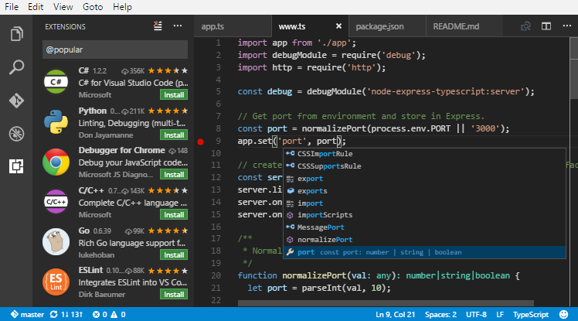
Visual Studio Code

Slide 9
C# - Conditionals
var i = 10;
if (i > 0)
{
// do something awesome
}
else
{
// don't do something awesome
}

Slide 10
C# - Loops
for (var i = 10; i >= 0; i--)
{
// do something 10 times
}

Slide 11
Demo

Slide 12
Thoughts on the Demo
MSBuild
Compiled vs Interpreted
Object Oriented Programming
Don’t reinvent the wheel
Explore the framework - https://docs.microsoft.com/en-us/dotnet/api/?view=netframework-4.7
Different Tools
Visual Studio
Powershell

Slide 13
Resources
https://github.com/hsv-dotnet-meetup/introduction-to-microsoft-dotnet
https://docs.microsoft.com
https://www.microsoft.com/net/download
https://code.visualstudio.com

Slide 14
Questions?

